Slide 1
Education Statistics
@ Warwick Resort: 22nd July 2026

Slide 2
Education Statistics Overview
Monitoring Equity & SDG 4: Tracks key indicators—such as literacy, enrollment, completion, and pupil-teacher ratios—disaggregated by gender, disability, and province to measure progress toward Sustainable Development Goal 4 (Quality Education).
2. Cross-System Data Integration: Harmonizes household survey and census data with administrative records from the Ministry of Education and Training (Open VEMIS) to build comprehensive national baselines.
3. Evidence-Based Policy & Planning: Provides high-quality, localized education data to guide government resource allocation, school infrastructure planning, and target educational support for vulnerable and rural populations.

Slide 3
Education Sector Within Vanuatu Bureau of Statistics
Conduct Census and Surveys :Census – Education Statistics baseline questions
Surveys – Education questions into Surveys Questionnaires
- Use Education data for any Statistics Request
2. Collect Education Administrative Data :-Collect Administrative data with every Education Stakeholder
-To update Education Indicators in NSDP
- Use Education data for any Education Statistics Request

Slide 4
Link to Education Dashboard and NSDP Platform
NSDP Data Portal : Created by VBoS –Using Administrative data from Education Stakeholders : Society Pillar 2 – Soc:Pillar 2.1-1-2.4.1
https://nsdp.vnso.gov.vu/
Education Dashboard: Created by VBoS Using Education administrative data from Statistical Report and Education Digest Report:
https://vbos-social-section.github.io/education-dashboard/

Slide 5
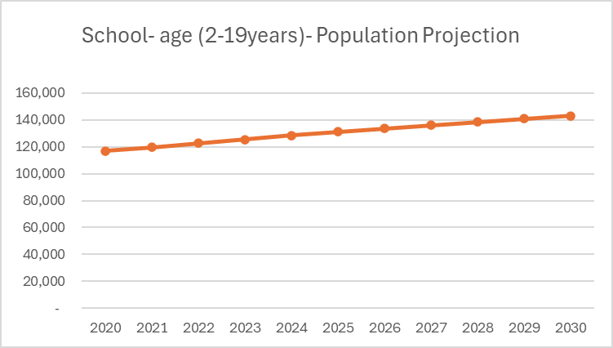
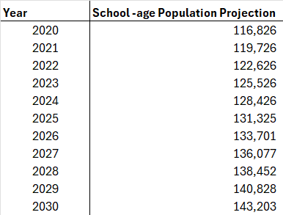
School- Age Population Projection Trend from 2020-2030
Source : 2020 Population Census –VBoS

Slide 6
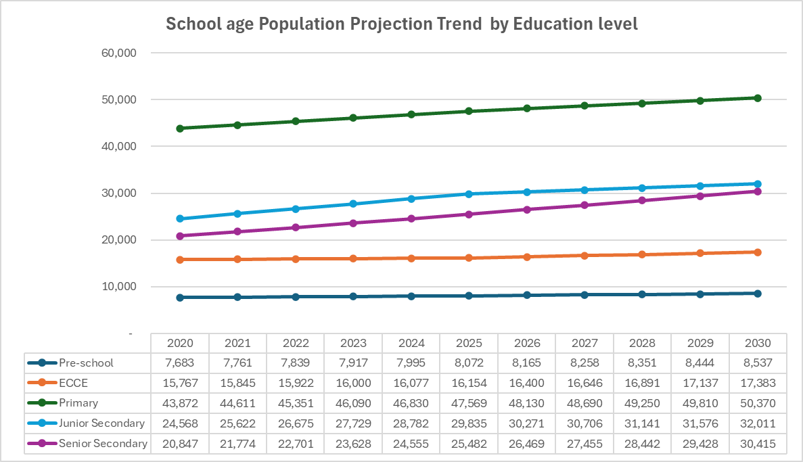
School- Age Population Projection Trend by Education Level
Source : 2020 Population Census –VBoS

Slide 7
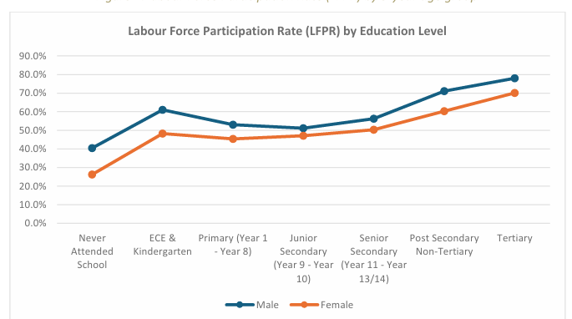
Educational Attainment of 2024 Labour Force Participants.
 | Education attainment (16+)
 | SEX |  | Region |  | Total
Education Attainment (16+) | Male | Female | Urban | Rural
Never attended school | 40.5% | 26.3% | 41.2% | 32.2% | 32.6%
ECE & Kindergarten | 61.0% | 48.3% | 63.8% | 54.3% | 54.8%
Primary (Year 1 | 53.0% | 45.4% | 60.5% | 47.5% | 49.3%
Junior Secondary (Year 9- Year 10) | 51.2% | 47.1% | 54.4% | 47.4% | 49.1%
Senior Secondary (Year 11- Year 13/14) | 56.3% | 50.3% | 54.8% | 52.3% | 53.1%
Post Secondary -Non Tertiary | 71.1% | 60.3% | 62.3% | 68.4% | 66.9%
Tertiary | 78.0% | 70.1% | 75.5% | 73.8% | 74.7%
Source: LFS, Vbos
( Source :Labour Force Survey )

Slide 8
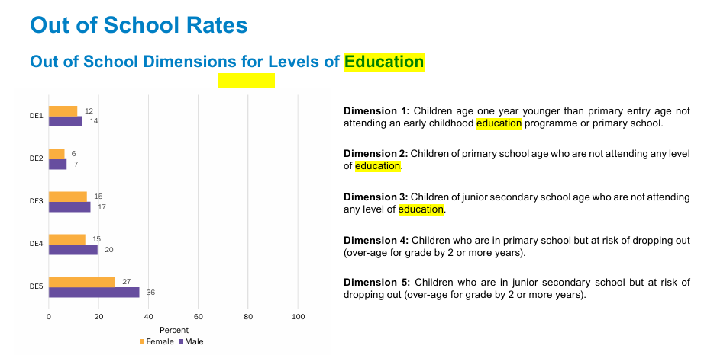
Education Dropout from Multiple cluster Survey ( MICS)
Source : MICS Survey

Slide 9
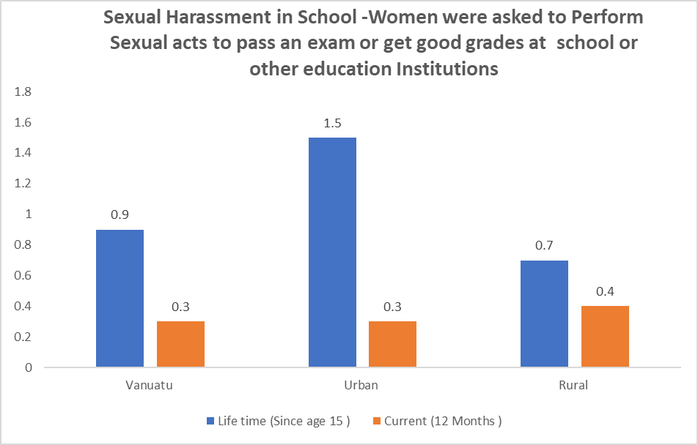
Sexual Harassment in Schools
(Women's Life and Family Relationship Survey , 2025 )

Slide 10
Conclusion and Recommendation

